Slide 1


Local Tourism Guide App
Instructor: Dr. Neha Ijaz
Section: 1239
Prepared By:
Sarah AlJurbua 220410528
Nouf Alfaiz 219410112
Renad Altufayl 218410450

Slide 2
Phase 1

Slide 3
Phase 1 Contents
Scope Statement
Stakeholders List
4
2
3
1
5
Problem Statement
Project Goals
Requirements

Slide 4
Problem + Scope Statement
-Riyadh is rich with its cultural heritage, its beauty in nature and buildings as well as the numerous attractions within our area that most tourists and even often residents are unaware of such experiences. All existing resources that helped previous residents and tourists are outdated due to the rapid change we see in the city. This leads to missed opportunities for consumers to experience as well as for local business hosters. This is happening due to the lack of centralized and user-friendly platforms that make it easier for everyone, residents or tourists, to browse. This is where creating websites and programs takes place to help users make their lives easier. Users using GetTourism will be able to schedule, register, and straightforwardly find activities. Existing websites we found have some problems in user experience, interface, ordering of functionalities, and delay in the program. This closing gap not only helps the economy of Riyadh grow but also hampers the growth of local tourism’s reputation.
-We are meticulously crafting "GetTourism," the app features include a straightforward activity registration process, personalized user profiles for guests, members, and tour guides, and direct connectivity with tour guides for an enhanced touring experience.
Goals:
-Centralization
-User-Friendly Experience
-Streamlined Booking Process

Slide 5
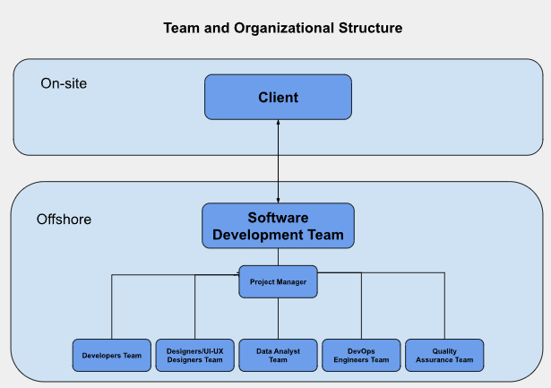
Stakeholders List
Users
Developers and Technical Team
Security Experts
Marketing agencies
Tour providers
Financial Institutions
Historical and Cultural Experts
Transportation Providers
Data Analytics Specialists
Language and Cultural Experts

Slide 6
Functional & Non-Functional Requirements
Functional:
The system should allow users to register activities.
The system should allow users to log in.
The system should allow users to sign up.
The system should allow users to continue as guest profiles.
The system should allow the user to use the map to see the location of the activity.
The system should allow users to contact a tour guide.
Nonfunctional:
The system should be accessible to everyone.
The system must be able to manage and support 1000 users at once.
The system should be clear and usable, not ambiguous, and hard to understand.
The system should be used only via mobile devices and IOS specifically.

Slide 7
Phase 2

Slide 8
Phase 2 Contents
Agile Driven metho.Option
Chosen Methodology
Survey Overview
4
2
6
3
1
5
Plan Driven metho.Option
Explored Methodology Risk Reg.
Lo-Fi + Hi-Fi Prototype

Slide 9
Plan drive Methodology options
Waterfall
Spiral
Why?
Why?
The Spiral methodology supports iterative improvement and stakeholder feedback, making it flexible for evolving projects like the Neighborhood Tourism Direct App. However, it's complex and requires careful management, active stakeholder involvement, and can lead to challenges in time and resource management, as well as increased documentation and communication efforts.
Provides a structured, linear approach with clear phases and milestones, aiding systematic project management and documentation. However, its limited flexibility can pose challenges in accommodating changes and evolving requirements, necessitating careful consideration of project needs and team dynamics before adoption.

Slide 10
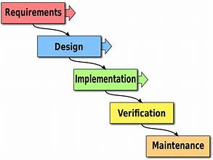
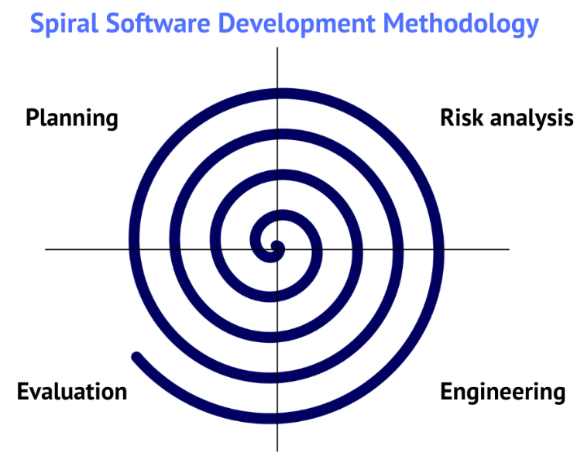
Waterfall
Spiral

Slide 11
Agile Methodology options
Scrum methodology
XP methodology
Facilitates iterative development through short sprints, ideal for a small development team managing tourism-related features. While fostering collaboration and time management, it requires experienced team members and may pose challenges with fixed sprint durations conflicting with project scheduling needs.
Prioritizes software engineering practices like TDD and CI, fostering high code quality and customer involvement for rapid feedback. While aligning well with diverse stakeholders and team structures, its heavy reliance on discipline and customer availability may challenge planned schedules and pace of development.

Slide 12
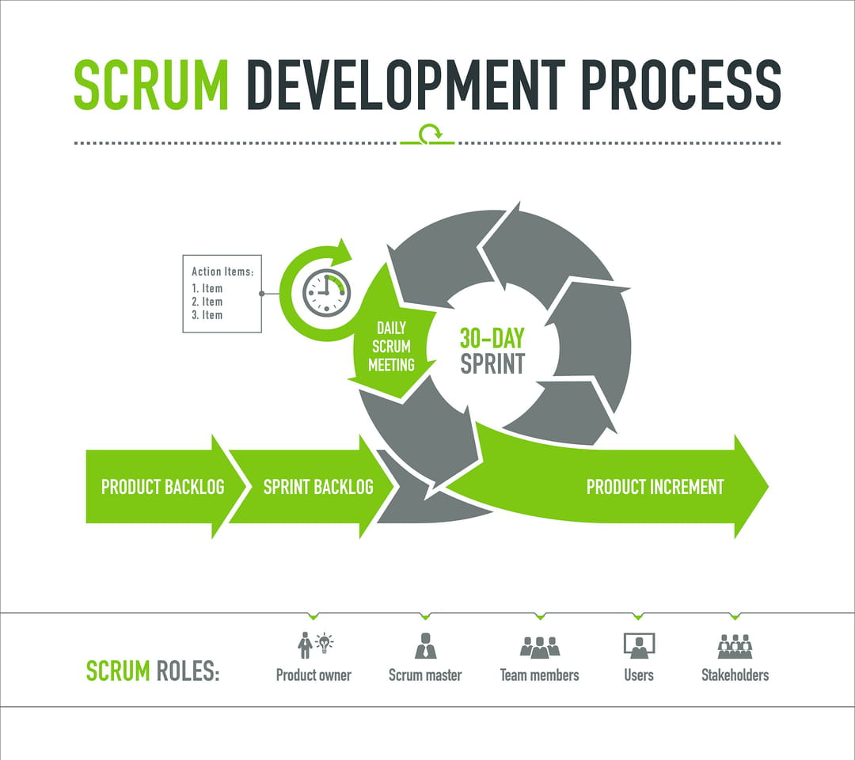
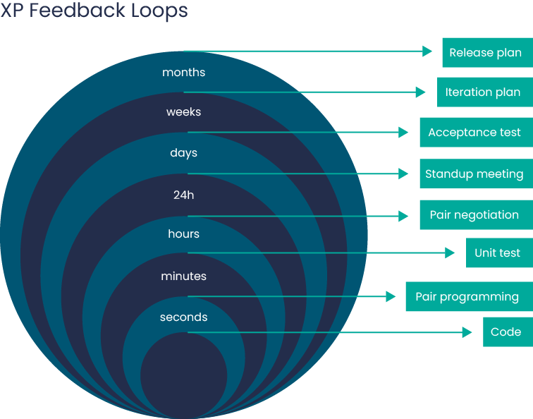
Scrum
XP

Slide 13
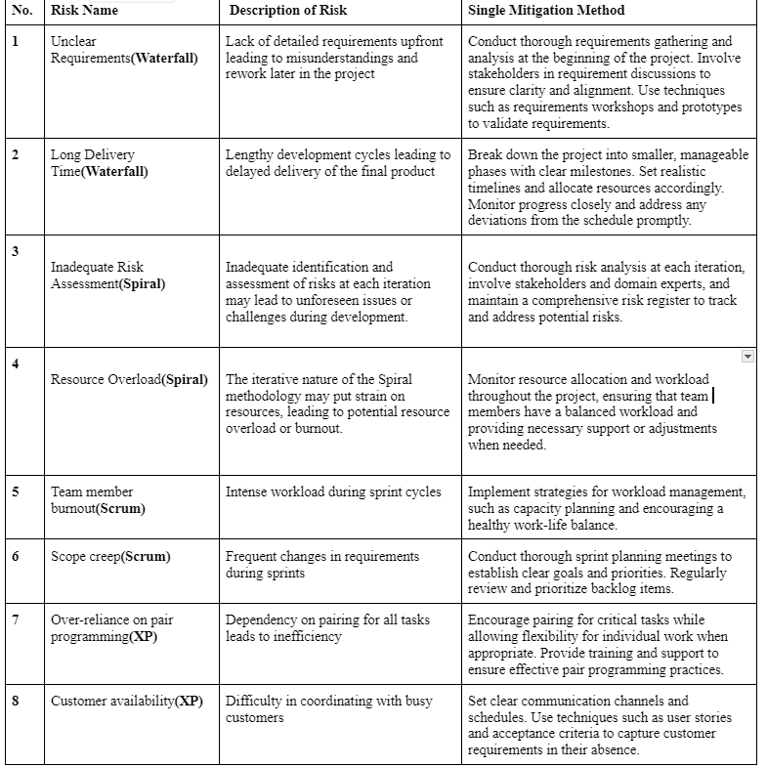
Explored Methodologies Risk Registers

Slide 14
Finalized Chosen Methodology
The XP approach was chosen over other options for several reasons, including:
1- Flexibility and Adaptability
2- Iterative Development
3- Focus on collaboration with customers
4- Continuous Testing and Quality Assurance
5- Team Collaboration and Communication
In conclusion, the XP methodology was chosen for the development of the local tourist guide app due to its emphasis on flexibility, iterative approach, collaboration with customers, quality assurance, and compatibility with the team structure. All points known about this methodology align perfectly with the needs and means to achieve the app of Local Tourism in KSA, therefore it was chosen over all other options of methodologies previously mentioned in the earlier part of this phase. XP methodology also aligns with all the points mentioned in the previous artifact such as the requirements and how to achieve them, making the decision to stick with this methodology a no-brainer.
The team believes that with XP, they can deliver a user-friendly and reliable app that meets the needs of residents, visitors, and other stakeholders in the local tourism industry.

Slide 15
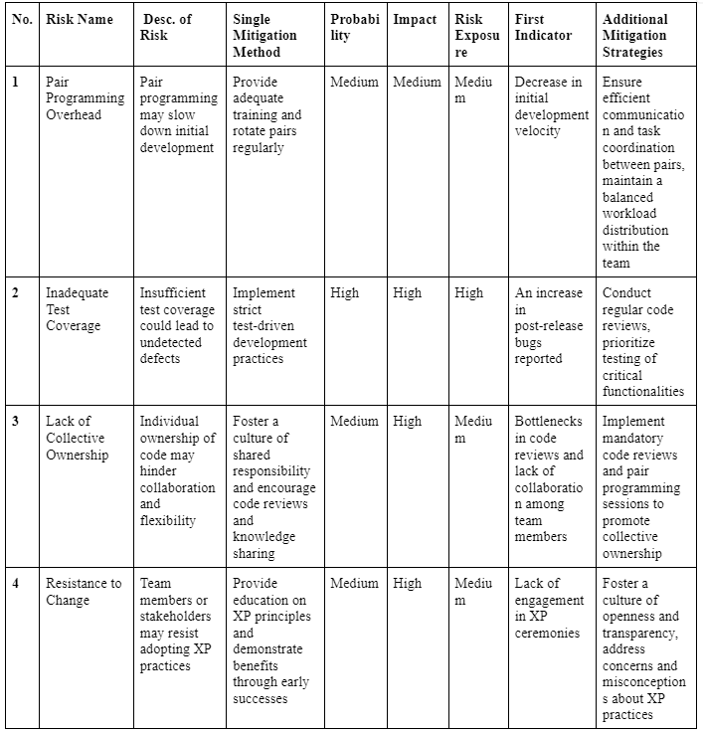
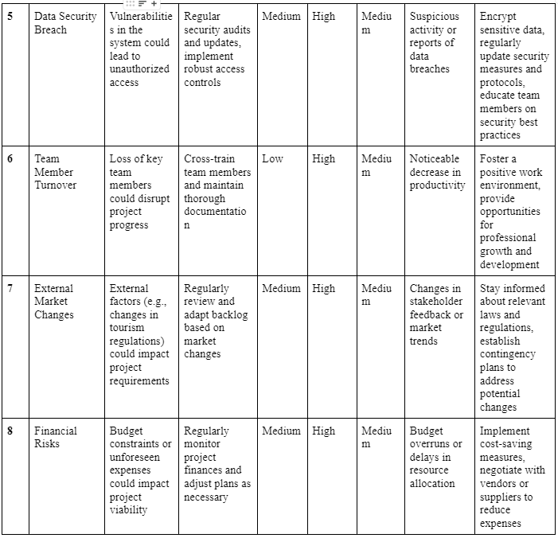
Finalized Methodology Risk Register

Slide 16
Final Preview of Prototype

Slide 17
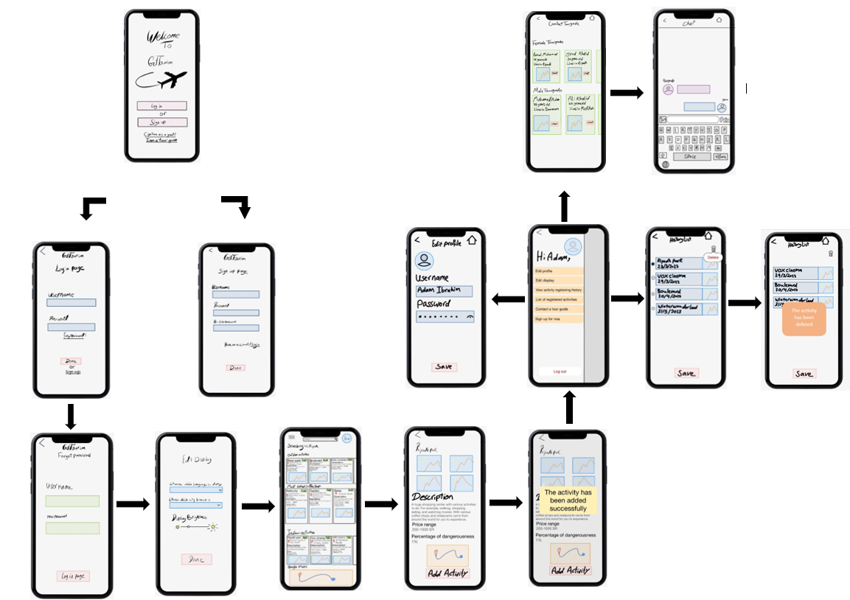
Low Fidelety Prototype

Slide 18
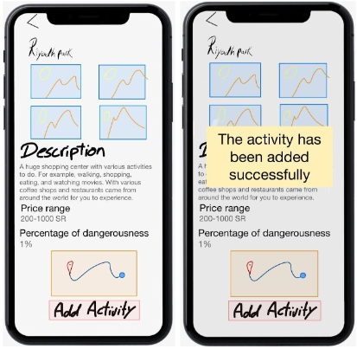
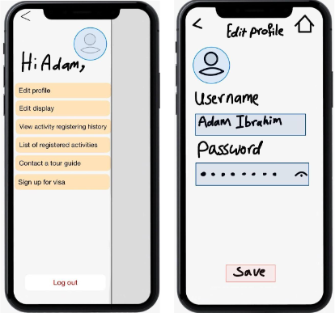
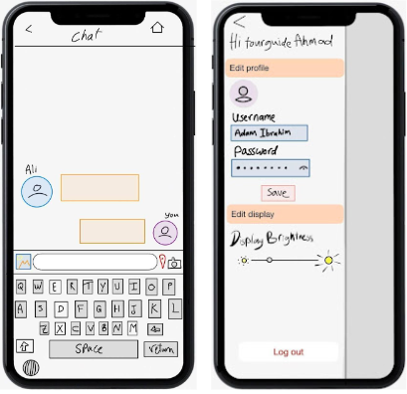

Slide 19
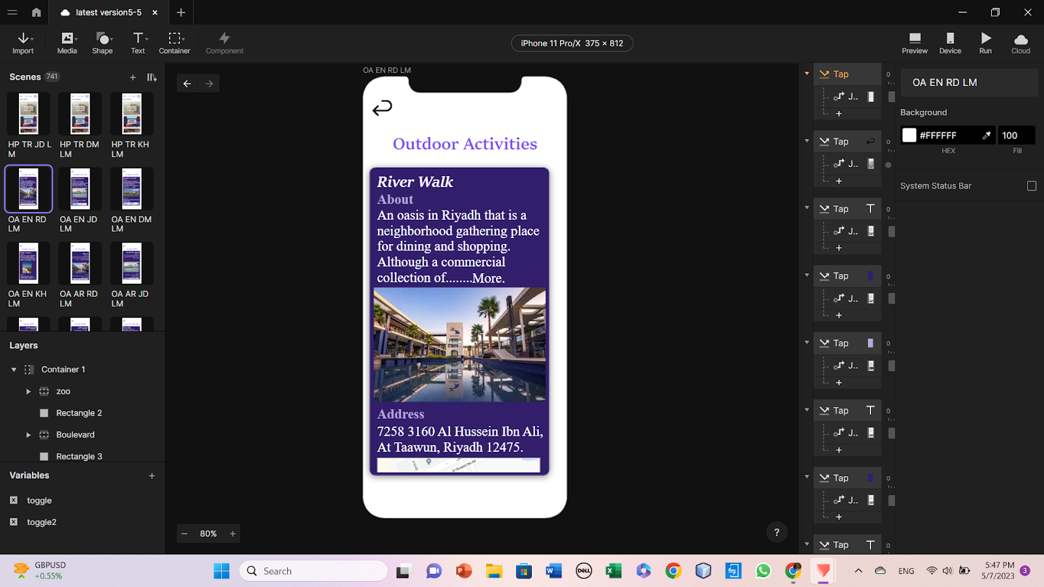
High Fidelety Prototype

Slide 20
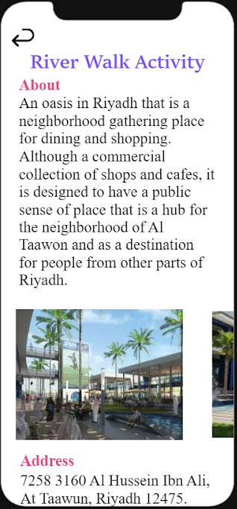
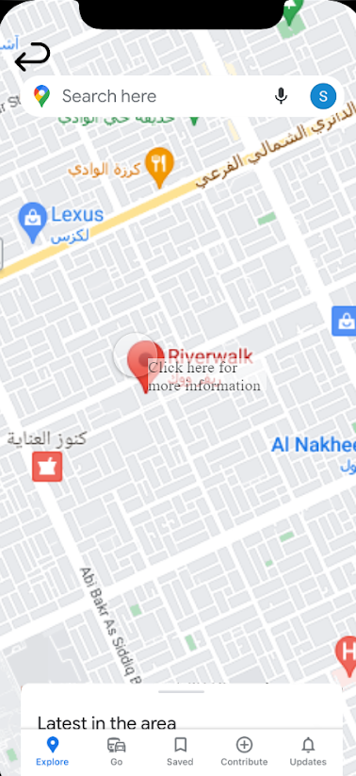
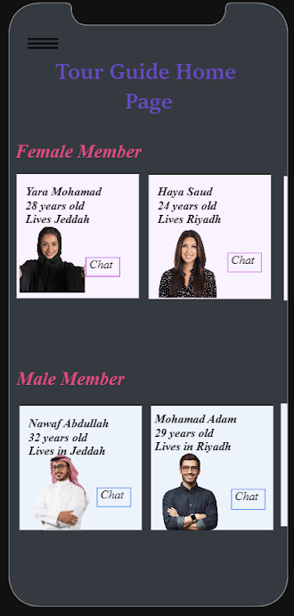
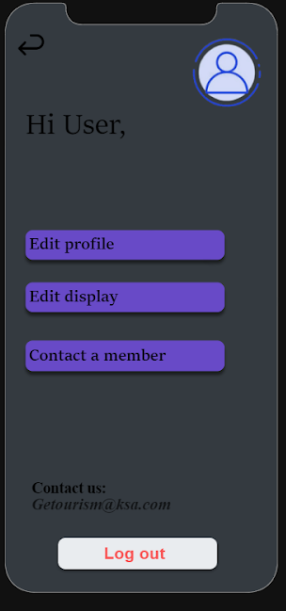

Slide 21
Survery and Responses
Survey:
https://docs.google.com/forms/d/e/1FAIpQLScCMmE7XaQCY-F2DnlaOw3echBP6pEzYu8tJ97yNK3wHGvtFg/viewform?usp=sf_link

Slide 22
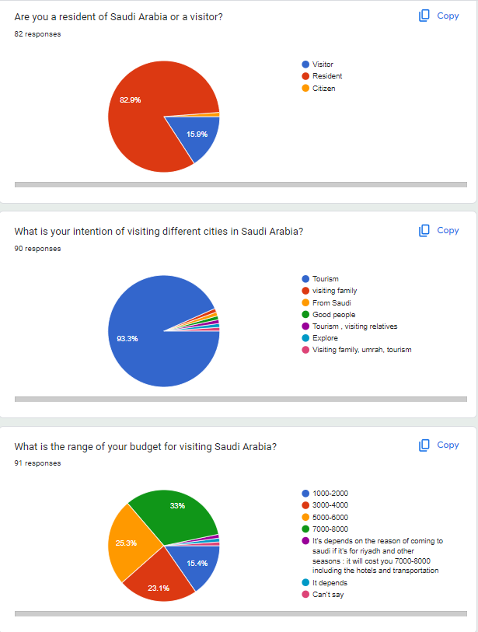
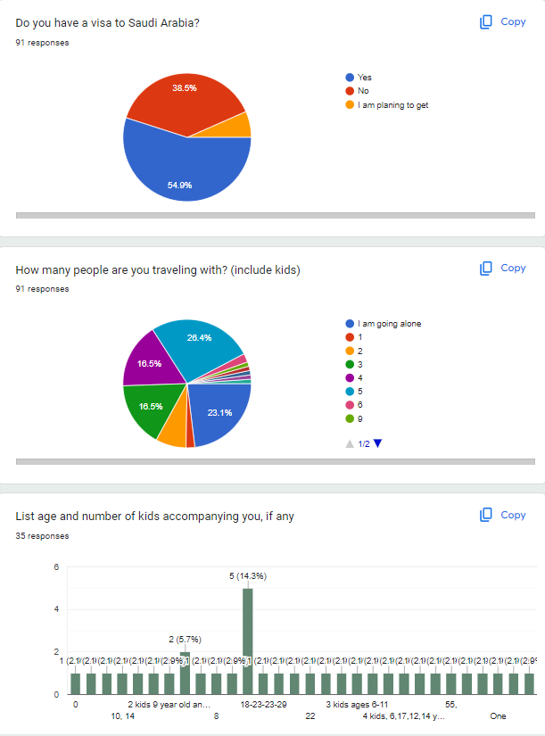
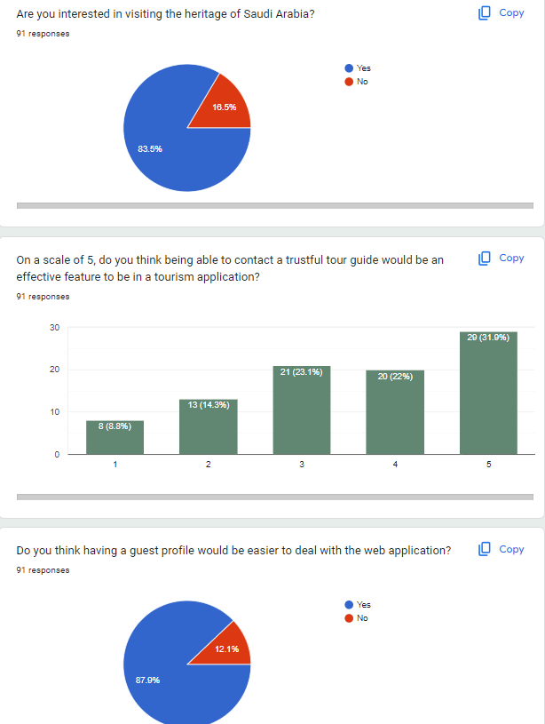
Responses

Slide 23
Phase 3

Slide 24
Phase 3 Contents
Agile Scheduling
Technical Process
3
2
2.1
1
4
Estimating
Product Backlog
1 Sprint Backlog
WBS

Slide 25
WBS (Work-Breakdown Structure)
4. Content Creation and Management
4.1 Gather and create activity content (descriptions, images, etc.)
4.2 Curate and manage activity database
4.3 Implement content update and synchronization mechanisms
5. User Feedback and Reviews
5.1 Develop user feedback and review system
5.2 Implement rating and review features
6. Quality Assurance and Testing
6.1 Conduct functional testing
6.2 Perform usability testing
6.3 Conduct security testing
6.4 Fix bugs and issues
7. Deployment and Launch
7.1 Prepare for app deployment
7.2 Publish app on relevant platforms (iOS, Android)
7.3 Promote the app through marketing channels
7.4 Monitor app performance and user feedback
8. Project Management and Documentation
8.1 Project scheduling and tracking
8.2 Documentation of project deliverables
8.3 Risk management and mitigation
8.4 Communication and coordination among team members
8.5 Final project report preparation
1. Project Initiation
1.1 Define project objectives and scope
1.2 Identify key stakeholders
1.3 Establish project team and roles
2. Requirements Gathering and Analysis
2.1 Conduct market research
2.2 Define functional requirements
2.3 Define non-functional requirements
2.4 Identify user personas and user stories
2.5 Create a stakeholder list
2.6 Define project goals and benefits
3. Design and Development
3.1 Develop user interface design
3.2 Create database structure
3.3 Implement registration and login functionality
3.4 Implement activity booking and scheduling features
3.5 Integrate map and location services
3.6 Develop communication features for users and tour guides
3.7 Implement user profile management
3.8 Implement search functionality
3.9 Implement activity history and deletion features
3.10 Develop multilingual support
3.11 Implement security measures to protect user data
3.12 Implement payment gateway integration
3.13 Perform testing and debugging

Slide 26
Product Backlog and Story Points
Residents
Users
Business owner
Admin

Slide 27
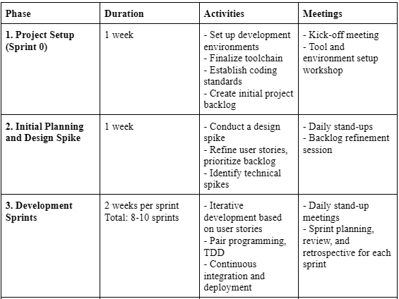
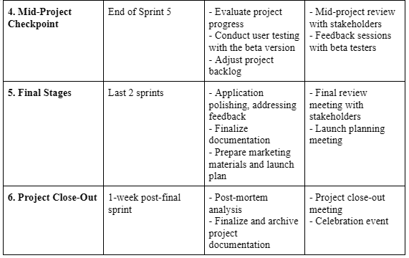
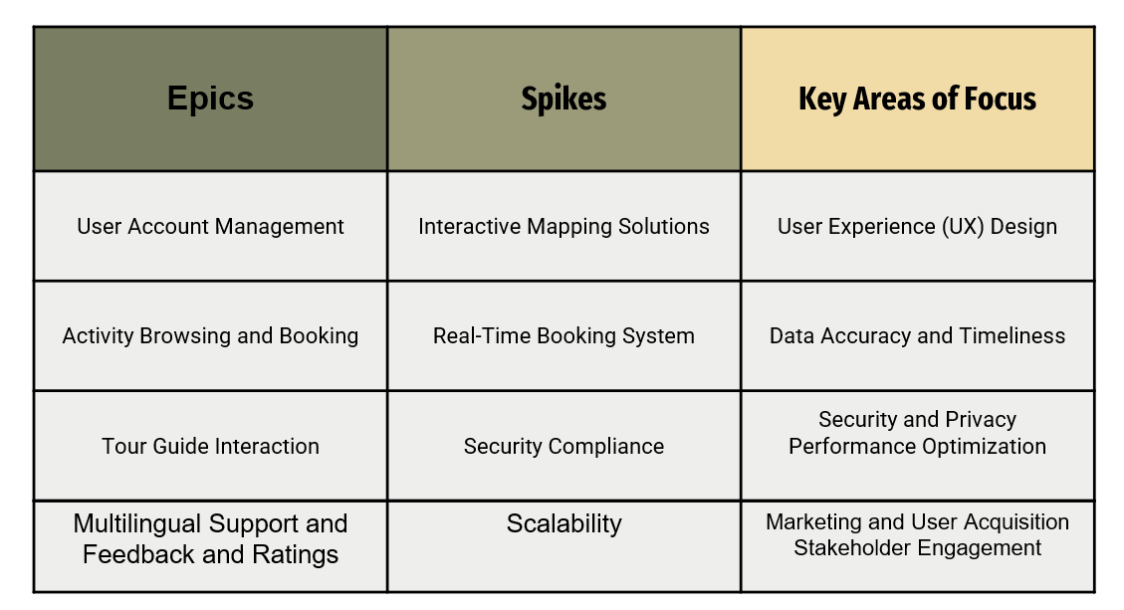
Technical Process & Additional Elements

Slide 28
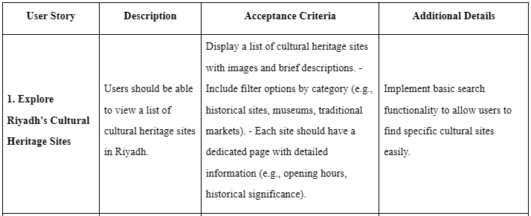
1 Sprint Backlog & Goals
5 User stories for 1 sprint backlog
Sprint 1 Goals:
Implement basic functionality for browsing and discovering attractions in Riyadh.
Enable users to register for guided tours and activities.
Provide users with detailed information about attractions and events.
Allow users to opt-in to receive real-time updates and notifications
Example:

Slide 29
Phase 4

Slide 30
Phase 4 Contents
Com. Plan
All Phases Ref.
4
2
3
1
Stakeholder Register
Metrics Chosen

Slide 31
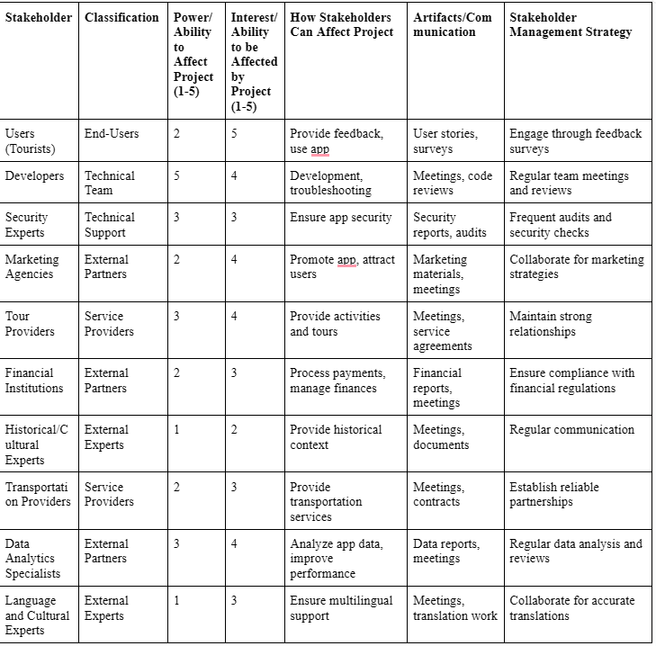
Stakeholder Register

Slide 32
Communication Plan & Metrics chosen
-Stakeholder Communication: Establish effective communication channels with all stakeholders involved in the project. This includes regular meetings, emails, and status updates to keep stakeholders informed about the progress, challenges, and decisions.
Team Communication: Foster open and transparent communication among team members. Encourage regular team meetings, both in-person and virtual, to discuss project updates, share ideas, address concerns, and collaborate on decision-making.
Meeting Schedule: Set up a meeting schedule to ensure regular communication and coordination. This can include weekly team meetings, bi-weekly stakeholder meetings, and ad-hoc meetings as needed.
-Metrics chosen: User Registration and Activity Booking, User Engagement, User Feedback and Reviews, System Performance, Security and Data Protection, Market Reach and Growth, Stakeholder Satisfaction.

Slide 33
References
-ProtoPie: High-Fidelity Prototyping for Mobile, Desktop, Web & IoT. (n.d.). ProtoPie. https://www.protopie.io/
-Google Forms: Online Form Creator | Google Workspace. (n.d.). https://www.google.com/forms/about/
-Nielsen, J. (2024, February 20). 10 Usability Heuristics for User Interface Design. Nielsen Norman Group. https://www.nngroup.com/articles/ten-usability-heuristics/

Slide 34
References
‌admin. (2018, May 6). Epic, Feature and Spike in Agile Development. TestingDocs.com. https://www.testingdocs.com/epic-vs-spike/
#molongui-disabled-link, M.B. (2022) What is a stakeholder register?, Project Management Academy Resources. Available at: https://projectmanagementacademy.net/resources/blog/what-is-a-stakeholder-register/ (Accessed: 21 April 2024).
Martins, J. (2024, January 16). How to write an effective communication plan [2024] • asana. Asana. https://asana.com/resources/communication-plan
Step-by-step Guide for Writing Technical Documents + Examples. (n.d.). Www.archbee.com. https://www.archbee.com/blog/technical-writing-process
#molongui-disabled-link, M.B. (2022) What is a stakeholder register?, Project Management Academy Resources. Available at: https://projectmanagementacademy.net/resources/blog/what-is-a-stakeholder-register/ (Accessed: 21 April 2024).
Martins, J. (2024, January 16). How to write an effective communication plan [2024] • asana. Asana. https://asana.com/resources/communication-plan

Slide 35
Questions?
&
Thank you!

